Slide 1
Photos & Movie Stills

Slide 2
Linux Commands Used in This Lab
Command | Purpose | Command Syntax Used | Explanation
scalpel | It is a file carving and data recovery tool. It is used to recover files based on their headers & footers. | scalpel -o output_directory disk-image.img | -o output_directory: Specifies the directory where recovered files should be saved. disk-image.img: Specifies the input device from which scalpel will recover files.
foremost | It is used to recover files based on their headers, footers, and data structures | foremost -o output-directory -i userdata.img -t jpg | -o output-directory: Specifies the output directory where the recovered files will be saved -i userdata.img: Specifies the input device or disk image (userdata.img) from which foremost will attempt to recover files. -t jpg: Specifies the file type to be recovered. In this case, it focuses on recovering JPEG images.

Slide 3
Linux Commands Used in This Lab
Command | Purpose | Command Syntax Used | Explanation
exiftool | ExifTool is used for reading, writing, and editing metadata in various file types, particularly in image files. Metadata contains information about the file, such as camera settings, date and time, GPS location, and more. | exiftool image.jpg | Display the metadata information for the specified image file.

Slide 4
Photos (Images)
Three types
Captured by the device camera
Downloaded from the cloud (Amazon Cloud)
Downloaded during activities like playing music, videos, and
None of these is saved on device file system
Conduct a search for file type jpg in user data partition and check

Slide 5
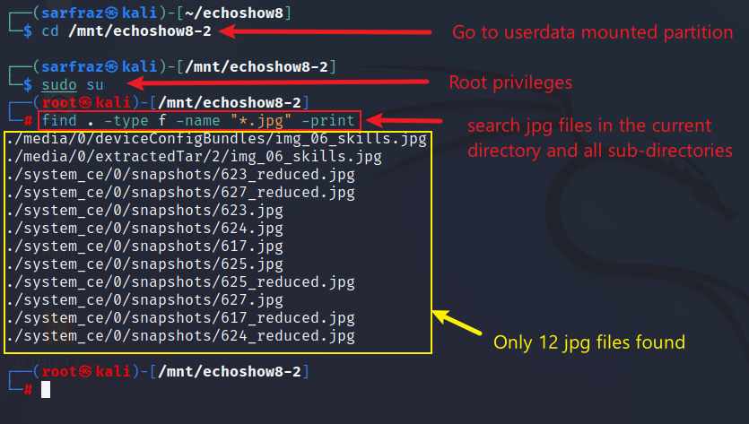
Search jpg files in userdata partition
Search jpg files with find command

Slide 6
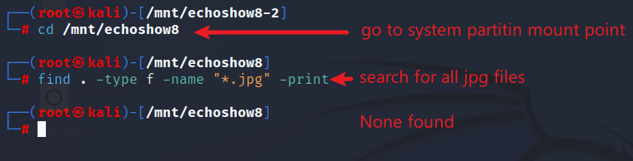
Search jpg files in system partition
Search jpg files with find command

Slide 7
Photos in Found File System
Only 12 jpg files found in userdata partition
No jpg files in system partition
No photos captured by the device camera, downloaded from the cloud or downloaded from internet found in the file systme
But, the photos can be recovered through data carving techniques

Slide 8
Data Carving
A process to extract or recover data from a hard drive or disk image, without relying on file system metadata.
Data carving tools look for specific signatures, headers, or footers (the beginning and end of files) to carve files
Useful when file system structures are damaged/corrupted/missing
Accessing files through traditional file system parsing methods is not possible

Slide 9
Scalpel – Data Carving Tool
Scalpel is a file-carving and data recovery tool
Extracts/carves files based on their headers & footers
Syntax: scalpel [options] device_or_image_name
Example: scalpel -c scalpel.conf -o output_directory /dev/sdX
-c scalpel.conf: Specifies the configuration file (scalpel.conf) that defines the file types & their headers/footers for carving process. If not specified, then default path is /etc/scalpel/scalpel.conf
-o output_directory: Specifies the output directory where recovered files should be saved. If not specified then scalpel creates an output directory.
/dev/sdX or disk_image.image: Specifies the input device/partition or disk image from which scalpel will recover files. Must be specified.

Slide 10
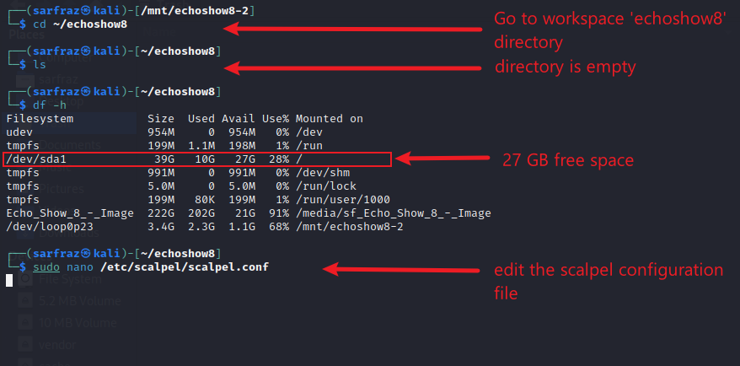
Carving Images (jpg files) with ‘scalpel’
Check available space

Slide 11
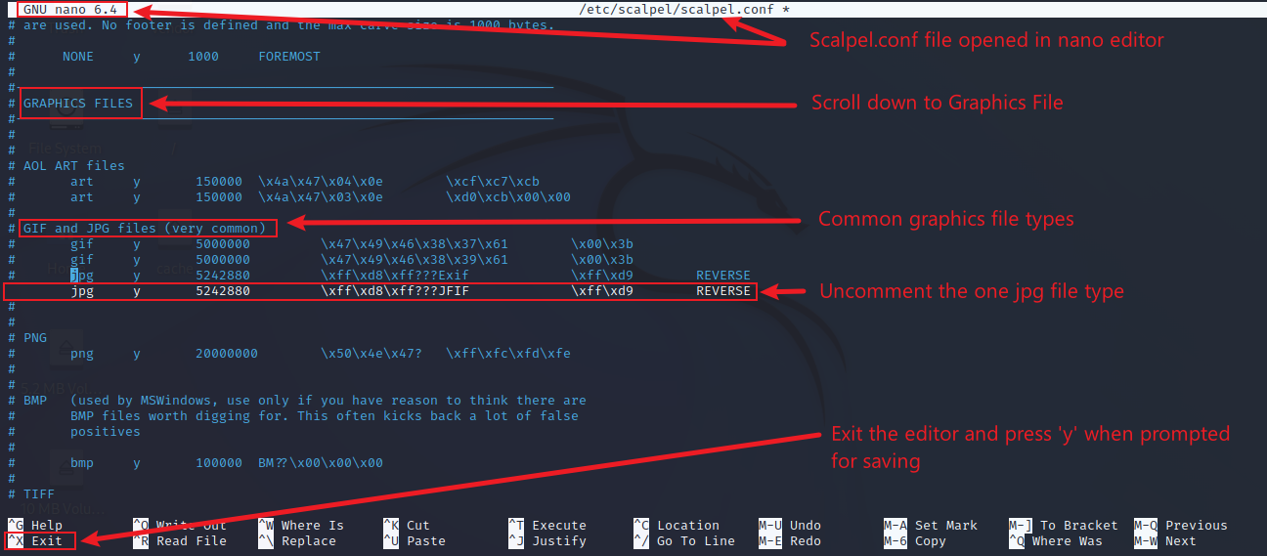

Carving Images (jpg files) with ‘scalpel’
Edit configuration file

Slide 12
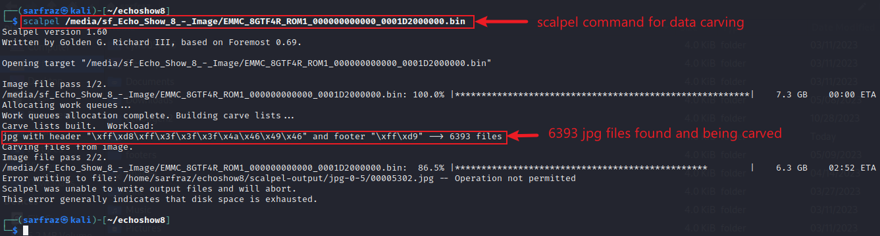
Carving Images (jpg files) with ‘scalpel’
Run scalpel command

Slide 13
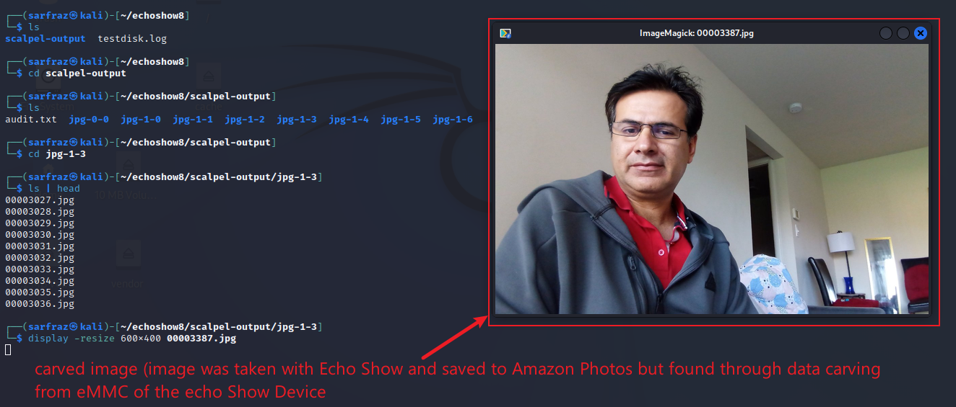
Carving Images – Image taken by Camera
Display Carved Photo - Photo taken by the device camera

Slide 14
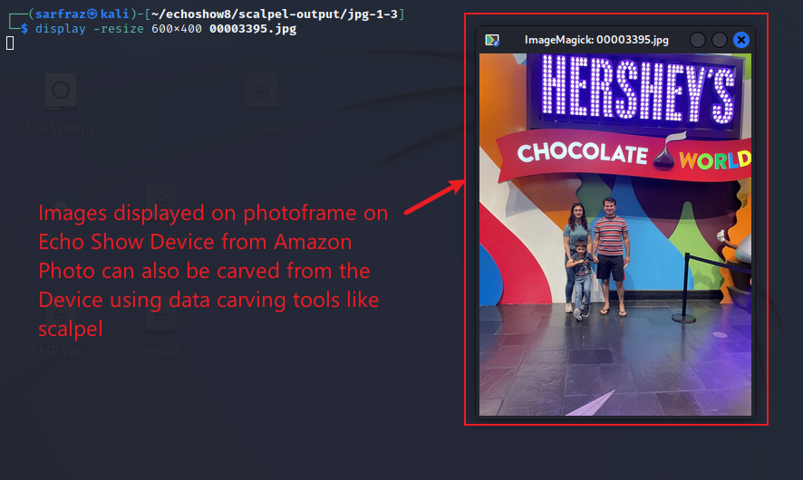
Carving Images – Image downloaded from cloud
Display Carved Photo - Photo downloaded from the cloud

Slide 15
Carving images (jpg)
Scalpel produces unnecessary large output
More than 27 GB for a 7.3 GB image file
Same images are carved multiple time
Foremost is a better, easier, and faster option

Slide 16
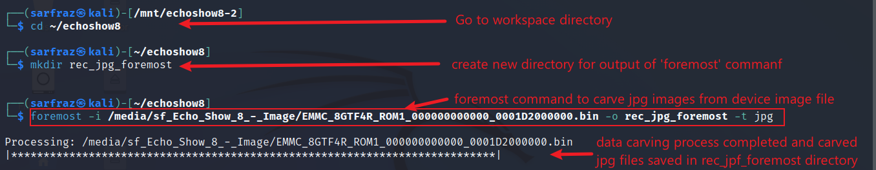
Carving Images with ‘foremost’
Create an output directory and run command

Slide 17
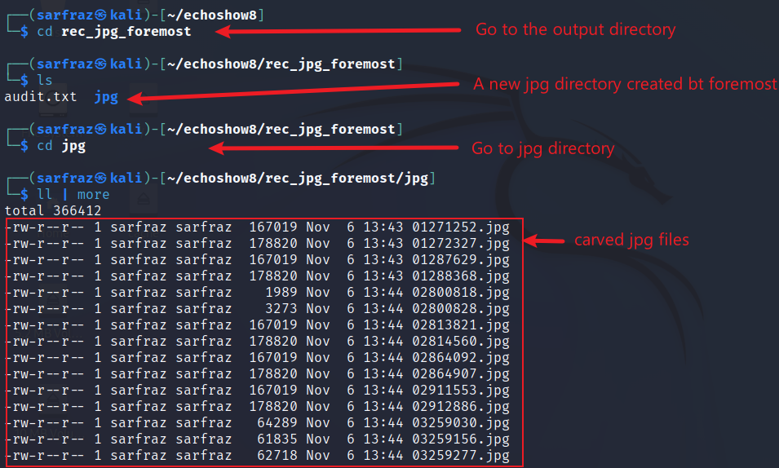
Carving Images with ‘foremost’
View output of foremost

Slide 18
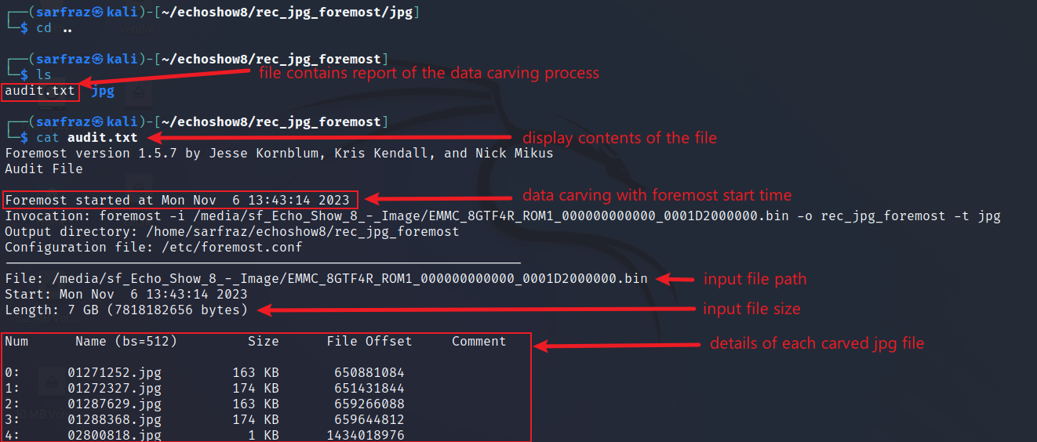
Carving Images with ‘foremost’
View audit report of foremost

Slide 19
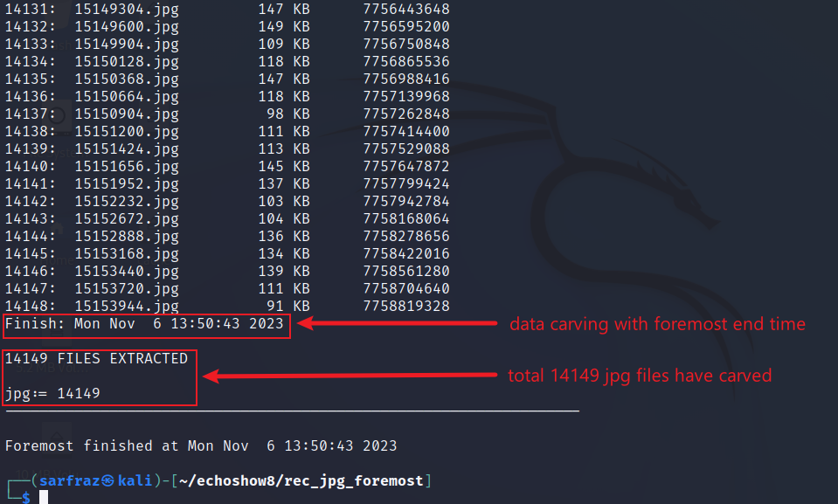
Carving Images with ‘foremost’
View audit report of foremost
14,149 jpg images carved by the foremost tool
Images carved from entire 7.3 GB disk image
File system had only 12 jpg images
The carved jpg images are those used by file system in activities and then deleted
But deleted files can be recovered by file carving tools

Slide 20
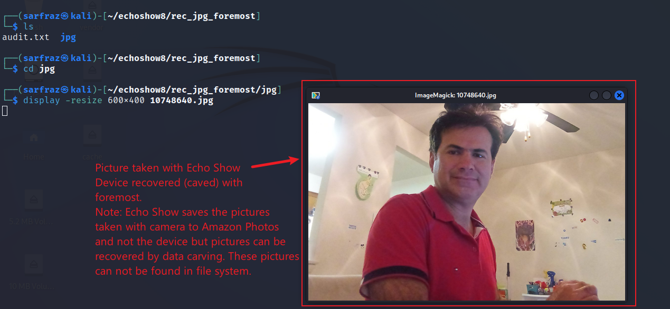
Carving Images – Image taken by Camera
Display Image taken by the device camera

Slide 21
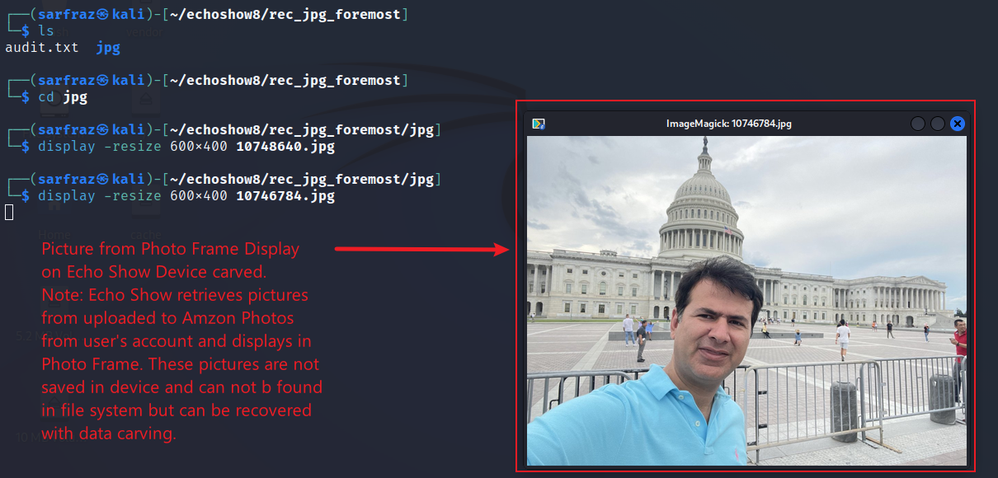
Carving Images – Image downloaded from cloud
Display Image downloaded from the cloud

Slide 22
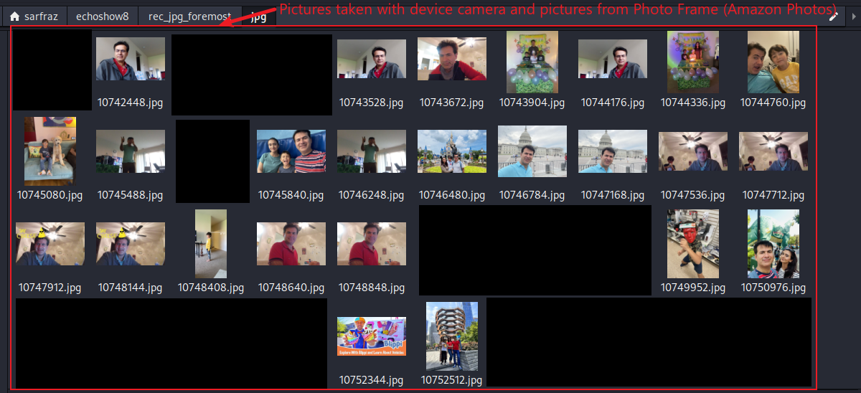
Carved Images (all images taken by camera & downloaded from the cloud)
Display Images captured by camera and downloaded from cloud

Slide 23
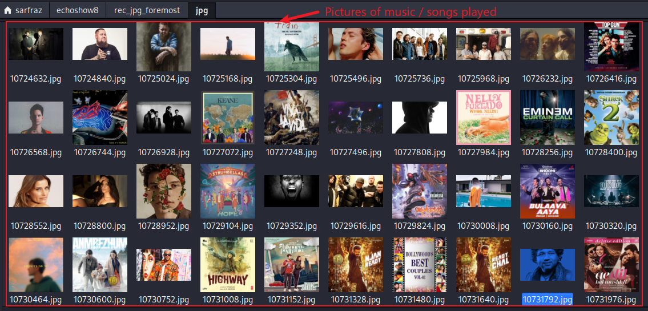
Carved Images (downloaded images displayed while playing music)
Display Image/screenshots taken by device while playing music

Slide 24
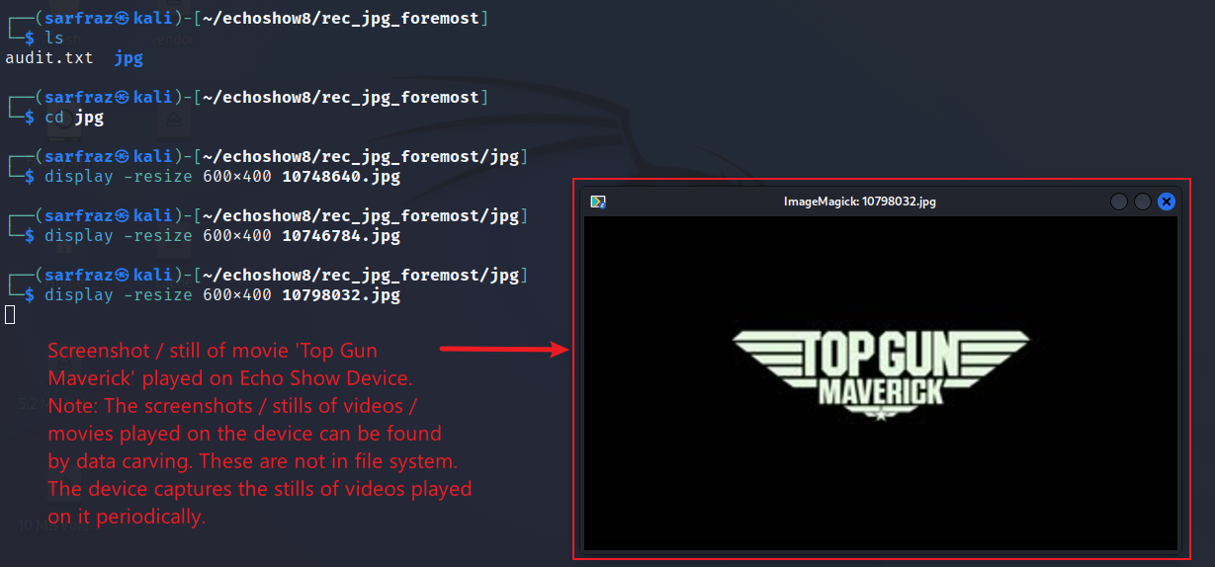
Carving Images – Screenshot captured during playing video
Display Image / screenshot captured while playing video

Slide 25
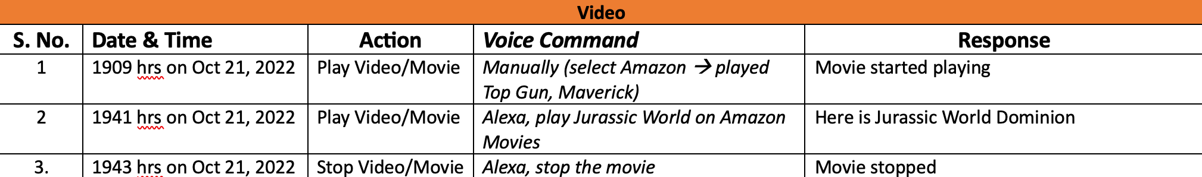
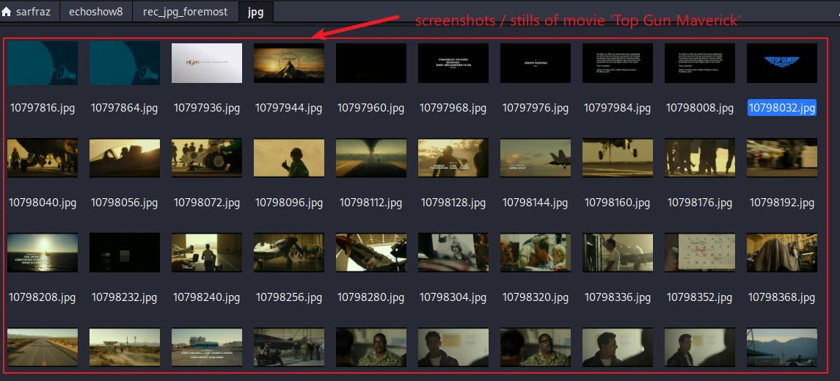
Movie stills
Display Image / screenshot captured while playing video
Device captures screenshots/stills of videos played or images displayed
These screenshots are not saved in the file system but are in unallocated space, which can be carved
This slides shows stills of ‘Top Gun Maverick’ movie played on device

Slide 26
Metadata of Recovered Photos (jpg)

Slide 27
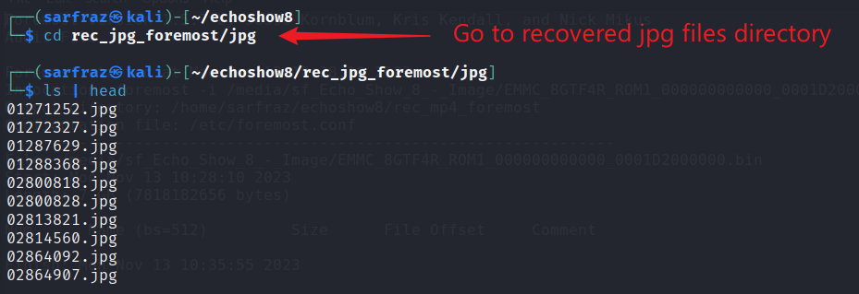
Metadata of Carved Photos (jpg)
Create a directory and run foremost

Slide 28
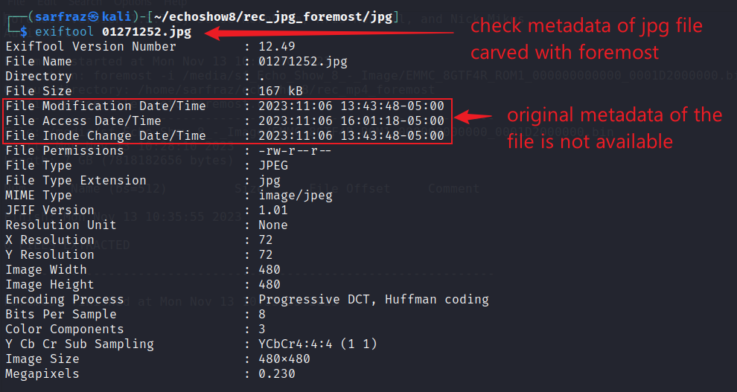
Metadata of Carved Photos (jpg)
Use ExifTool to view metadata
Carving tools, like foremost, extract raw file content during recovery.
Metadata, such as creation date, may be lost.

